Slide 1
A project final defense on Springball
Presentation by:
Krima Madhikarmi
Binisha Naga
Usha Suwal
Deepika Sainju

Slide 2
Table of content
Introduction
Problem Statement
Objectives
Scope
Block Diagram
Literature Review
Requirement Analysis
Feasibility Analysis
Algorithm

Slide 3
Table of content
10. Flowchart
11. Result
12. Test Cases
13. Limitation
14. Future Work
15. Recommendation
16. Conclusion

Slide 4
Introduction
2D Reference game of Popular ‘Flappy Bird’ game.
Fun to play.
Endless Obstacle.
Clear objective to avoid obstacle.

Slide 5
Problem Statement
Break from hectic schedule.
Overcome boredom
Refreshing
Excitement

Slide 6
Objectives
Utilize knowledge of C programming.
To ease the stress.

Slide 7
Scope
Executable in all Pc which have IDEs of C Language along with graphic library function.

Slide 8
Literature review
Programming Simplified
graphic.h function can be used to draw different shapes, display text in different fonts, change color and many more.
GeeksforGeeks
Different operations that can be performed on a file such as: Creation of a new file, opening an existing file, Reading from file, Writing to a file, moving to a specific location in a file and closing a file.

Slide 9
Literature review
The Conservation
Flow represents a mental state in which a person becomes so engrossed in a certain activity that enjoyment comes intrinsically from the process of doing that activity.
Video games are often built with the goal of providing a positive experience so that playing them becomes intrinsically rewarding.

Slide 10
Requirement Analysis
Functional Requirement
Major entities of game:
Main menu
Start game
Obstacles
Collide with ball
Game Over
Calculate Score

Slide 11
Requirement Analysis
Non-functional Analysis
Accessibility
Performance
Appearance

Slide 12
Feasibility Analysis
Technical feasibility
Operational feasibility
Economic feasibility
Schedule feasibility

Slide 13
algorithm
STEP 1: Start
STEP 2: Display menu
STEP 3: Choose 1 to start game, 2 to view score and 3 to
exit and store in choice.
STEP 4: If choice = 1, display instruction window.
Else if choice=2, display view score window
Else if choice=3, goto step 8.
Else goto step 2.
STEP 5: Enter any key to run the game.
STEP 6: If ball collide, display Game Over and score.
STEP 7: Goto step 2.
STEP 8: Exit

Slide 14
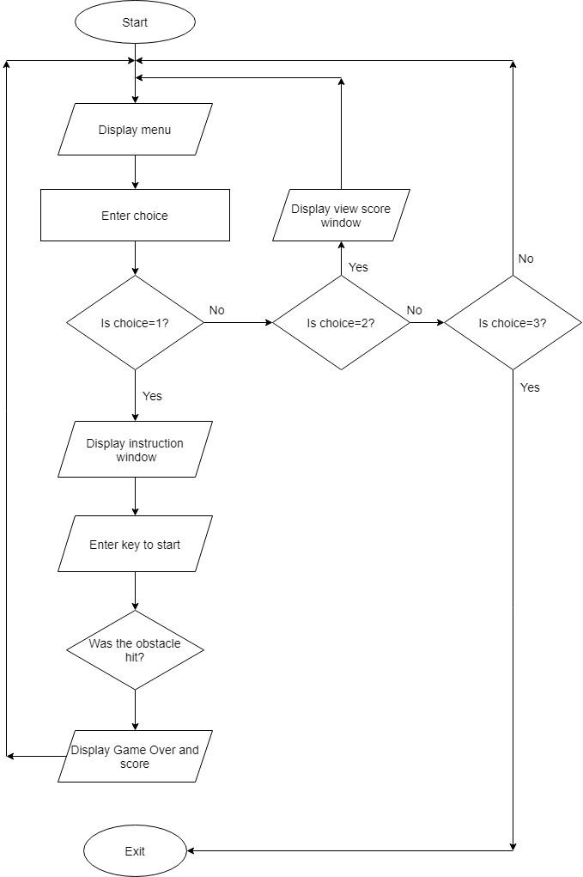
Flowchart:

Slide 15
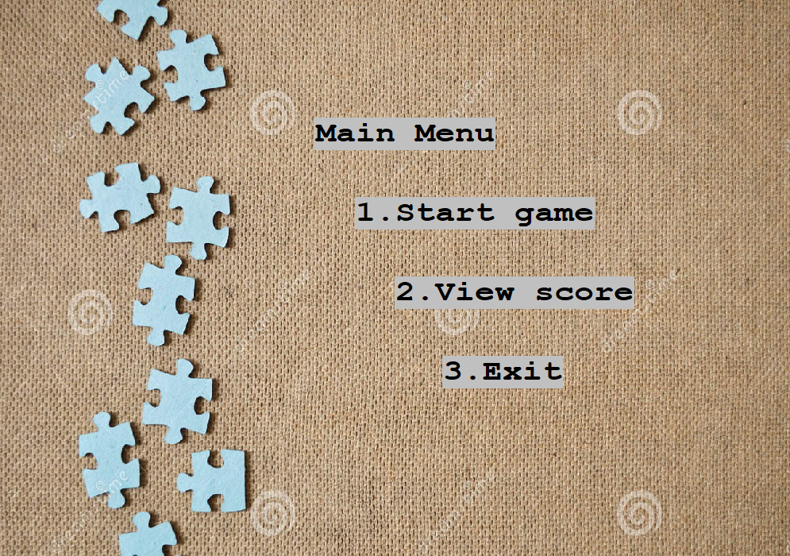
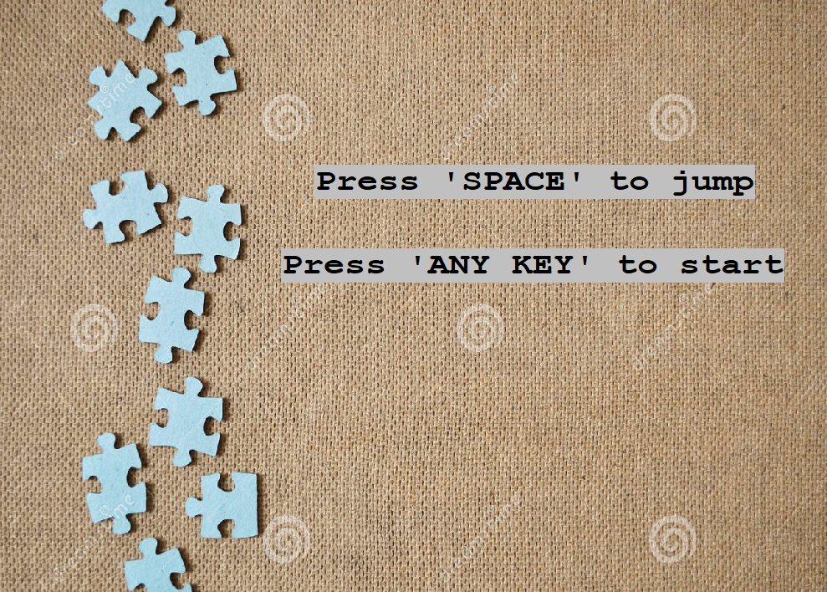
Results
Fig: Screenshot of main menu
Fig: Screenshot of Instruction Screen

Slide 16
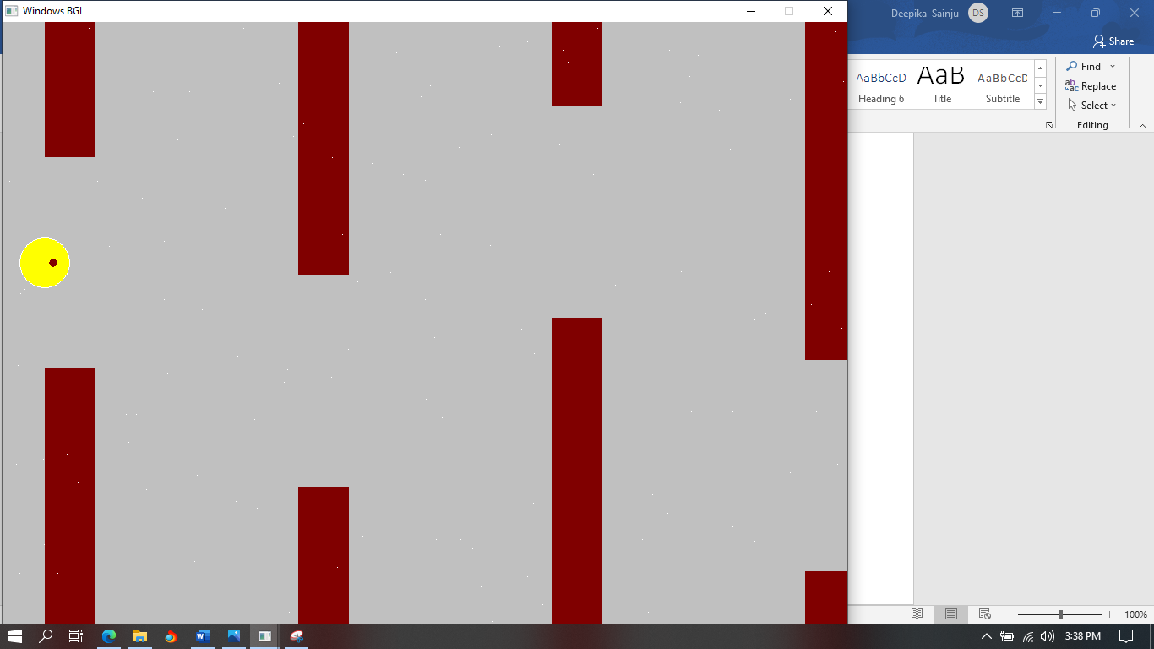
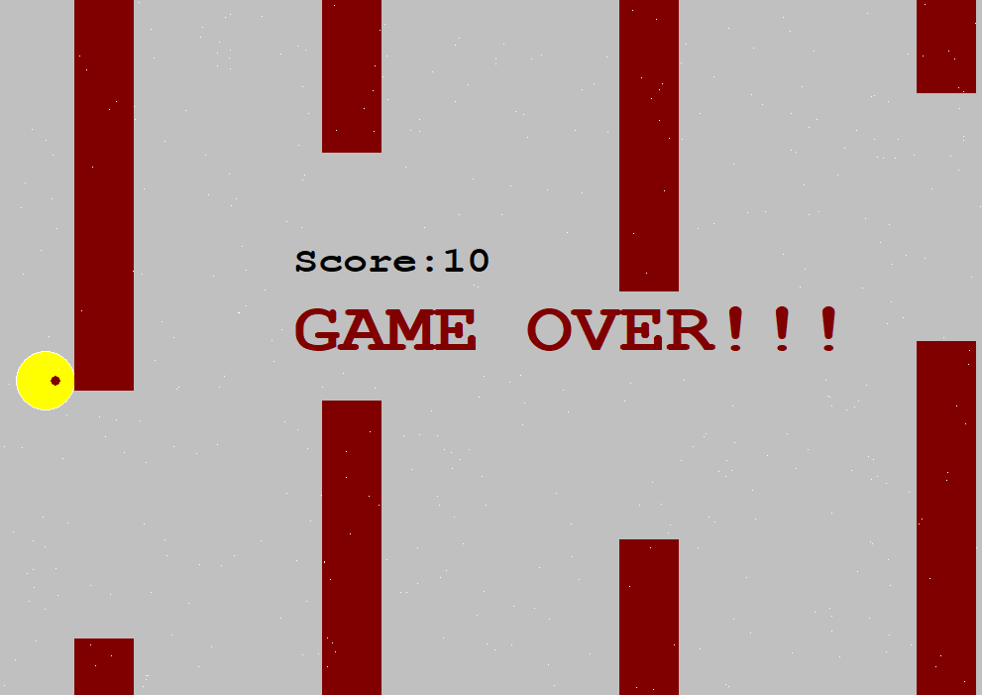
Results
Fig: Screenshot of Game screen
Fig: Screenshot of Game Over

Slide 17
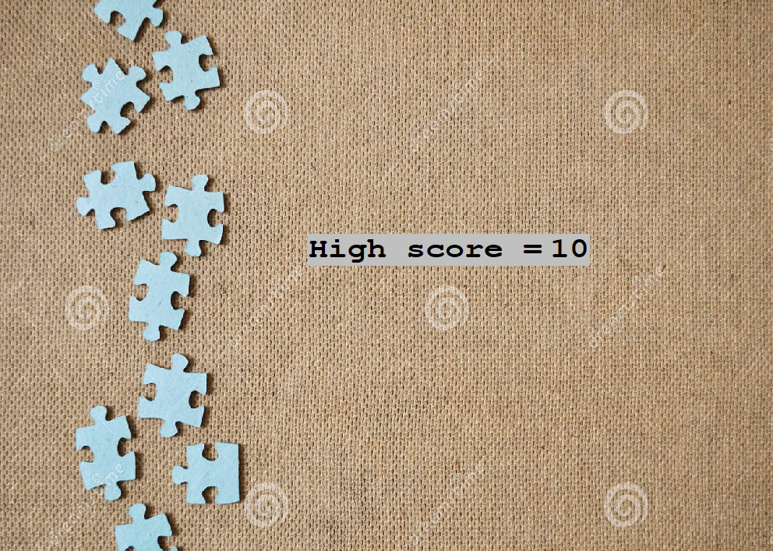
Results
Fig: Screenshot of View Score screen

Slide 18
Test cases
Test Case ID | TEST_001
Test case description | Showing front screen before starting the game.
Pre requisites | a. C compiler b. Graphics.h library
Test scenario | On opening EXEC file
Test data | Desired Screen Size (1000 x 800)
Steps | Expected Result | Actual Result | Pass/Fail
a. Open EXEC file. b. Provide desired screen size | Front screen should be shown | Front screen was shown | Pass

Slide 19
Test cases
Test Case ID | TEST_002
Test case description | Showing main menu after front screen and before starting game
Pre requisites | Running instance of the game.
Test scenario | After showing front screen.
Test data
Steps | Expected Result | Actual Result | Pass/Fail
Run EXEC file. | Main menu should be shown | Main menu was shown | Pass

Slide 20
Test cases
Test Case ID | TEST_005
Test case description | Movement on key press of space key only.
Pre requisites | a. C complier b. User interface. c. kbhit( ) function.
Test scenario | On key press of space key.
Test data | Space key.
Steps | Expected Result | Actual Result | Pass/Fail
a. Run the game. b. Start the game. c. Press<Space key> | Ball should move. | Ball moved | Pass

Slide 21
Limitation
Game flickering
Striking problem
Real time score
Background image unsupportive

Slide 22

Future work
Better design of the ball
Extra special point
Real time score

Slide 23

Recommendation
Use better IDE and graphics library
Be sure of your expectations

Slide 24
conclusion
Game development is interesting and delightful experience.

Slide 25
Reference
"Programming Simplified“
Available: https://www.programmingsimplified.com
"GeeksforGeeks,"
Available: https://www.geeksforgeeks.org.
"The Conversation"
Available: https://theconversation.com.

